Slide 1
2025 State Legislative and Federal Update
July 10, 2025

Slide 2

Agenda
Federal Updates
  HR1 – Big, Beautiful Bill Act
  Program Integrity Final Rule
2025 State Legislative Session Update
  South Dakota
  North Dakota
  Minnesota
  Wisconsin
  Iowa
Looking Ahead

Slide 3

Federal updates
Tone and Tenor of Administration
EAPTCs and ACA Policy
Medicare Advantage
Drug Pricing
Regulatory Activity
Virtual Care Waiver Expiration

Slide 4
Federal updates, cont’d
Big Beautiful Bill Act – HR1
Tax and Spending Bill with Healthcare Provisions
ACA Market Changes
  Pre-Enrollment APTC Eligibility Verification
  HSA Eligible Bronze Individual Products
  HDHP and First Dollar Telehealth Coverage
Medicaid Changes
  Work Requirements
  State Directed Payments
Provisions NOT Included

Slide 5
Federal updates, cont’d
Looking Ahead – What’s Next?
Federal Government Fiscal Year Ends September 31, 2025
  Virtual Care Waivers Expire at this Time – Medicare
  Unlikely – but possible – that Enhanced Premium Tax Credits are in consideration at this time.
Policy Issues on the Horizon
  Medicare Advantage – Coding and Prior-Authorization
  EAPTC Expiration – End of the Year
  PBM Reform
Regulations and RFIs – NBPP, PFS, Others

Slide 6
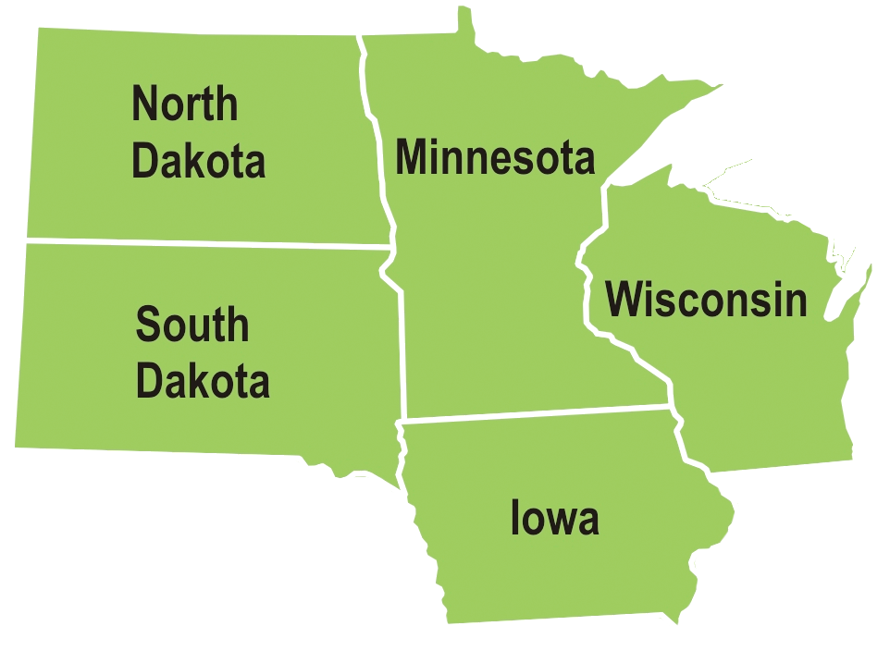
State session updates

Slide 7

General themes and commonalities
Affordability
Prior-Authorization
Coverage Requirements
Impact of Federal Policy Changes
Prescription Drugs

Slide 8
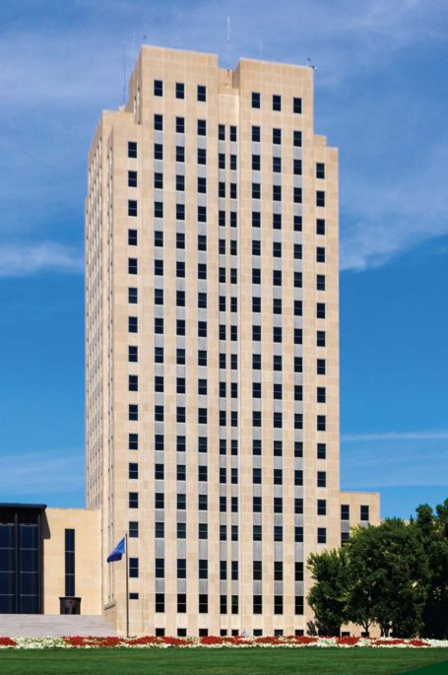
North Dakota Session update
Passed Legislation
SB 2280- Prior-Authorization
HB1248 - Coverage Mandate Process Reform
HB1584 – ERISA and PBM
SB2124 – MCAS Reporting
SB2348 – Health Care Sharing Ministries
HB1114 - $25 Insulin and Supplies Cap
HB1473 – 340B Contract Pharmacies
HB1322 – OON Ambulance Rate
HB1216 – Rx Coupons and Cost-Sharing to MOOP

Slide 9
North Dakota, cont’d
Failed Legislation
NDPERS Plan Transition – Non-Grandfathered
GLP1 Coverage Mandate
Fertility Treatment and Preservation Coverage Mandate
No Cost-Share Follow-Up Breast Examinations
Looking Ahead – Interim Period
Prior-Authorization and NDPERS
Health Insurance Historical Mandates
340B Reporting

Slide 10
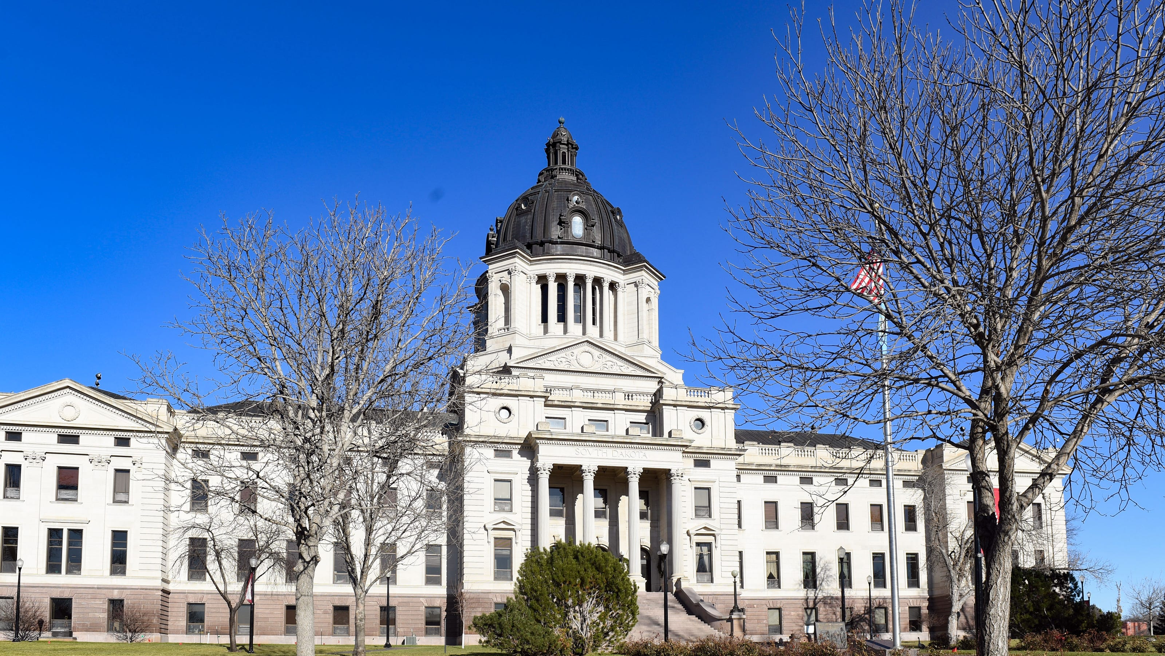
South Dakota session update
Passed legislation
SB154 – 340B Contract Pharmacy Protections
HJR5001 - Ballot Question – FMAP and Medicaid Expansion
Failed legislation
SB87/SB158 – Prior-Authorization Gold-Card
HB1070 – No Cost-Share Follow-Up Breast Exams
HB1137 – Non-Opioid Coverage Mandate

Slide 11
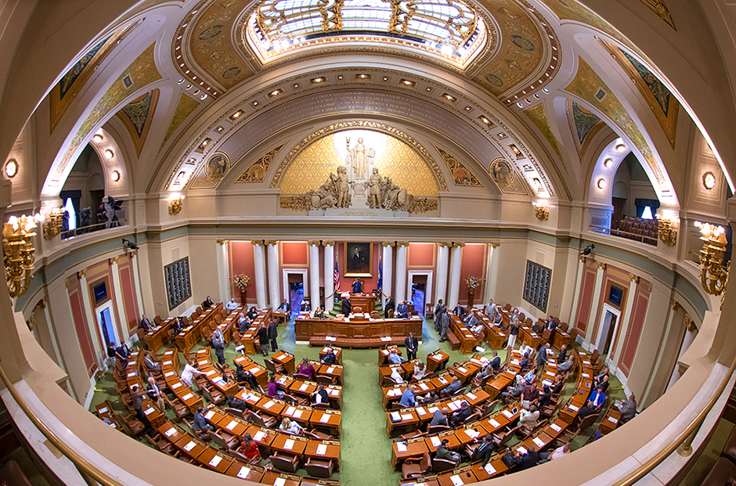
Minnesota session update
Political Environment and Makeup
Passed legislation
Reinsurance Extension (ND Model)
Audio Only Telehealth Payment Parity Extension
Electronic EOB
Hospital Directed Payment Program
Failed Legislation
Premium Subsidy in Lieu of Reinsurance
Public Option Stalls
Coverage Mandates
Facility Fee Ban

Slide 12
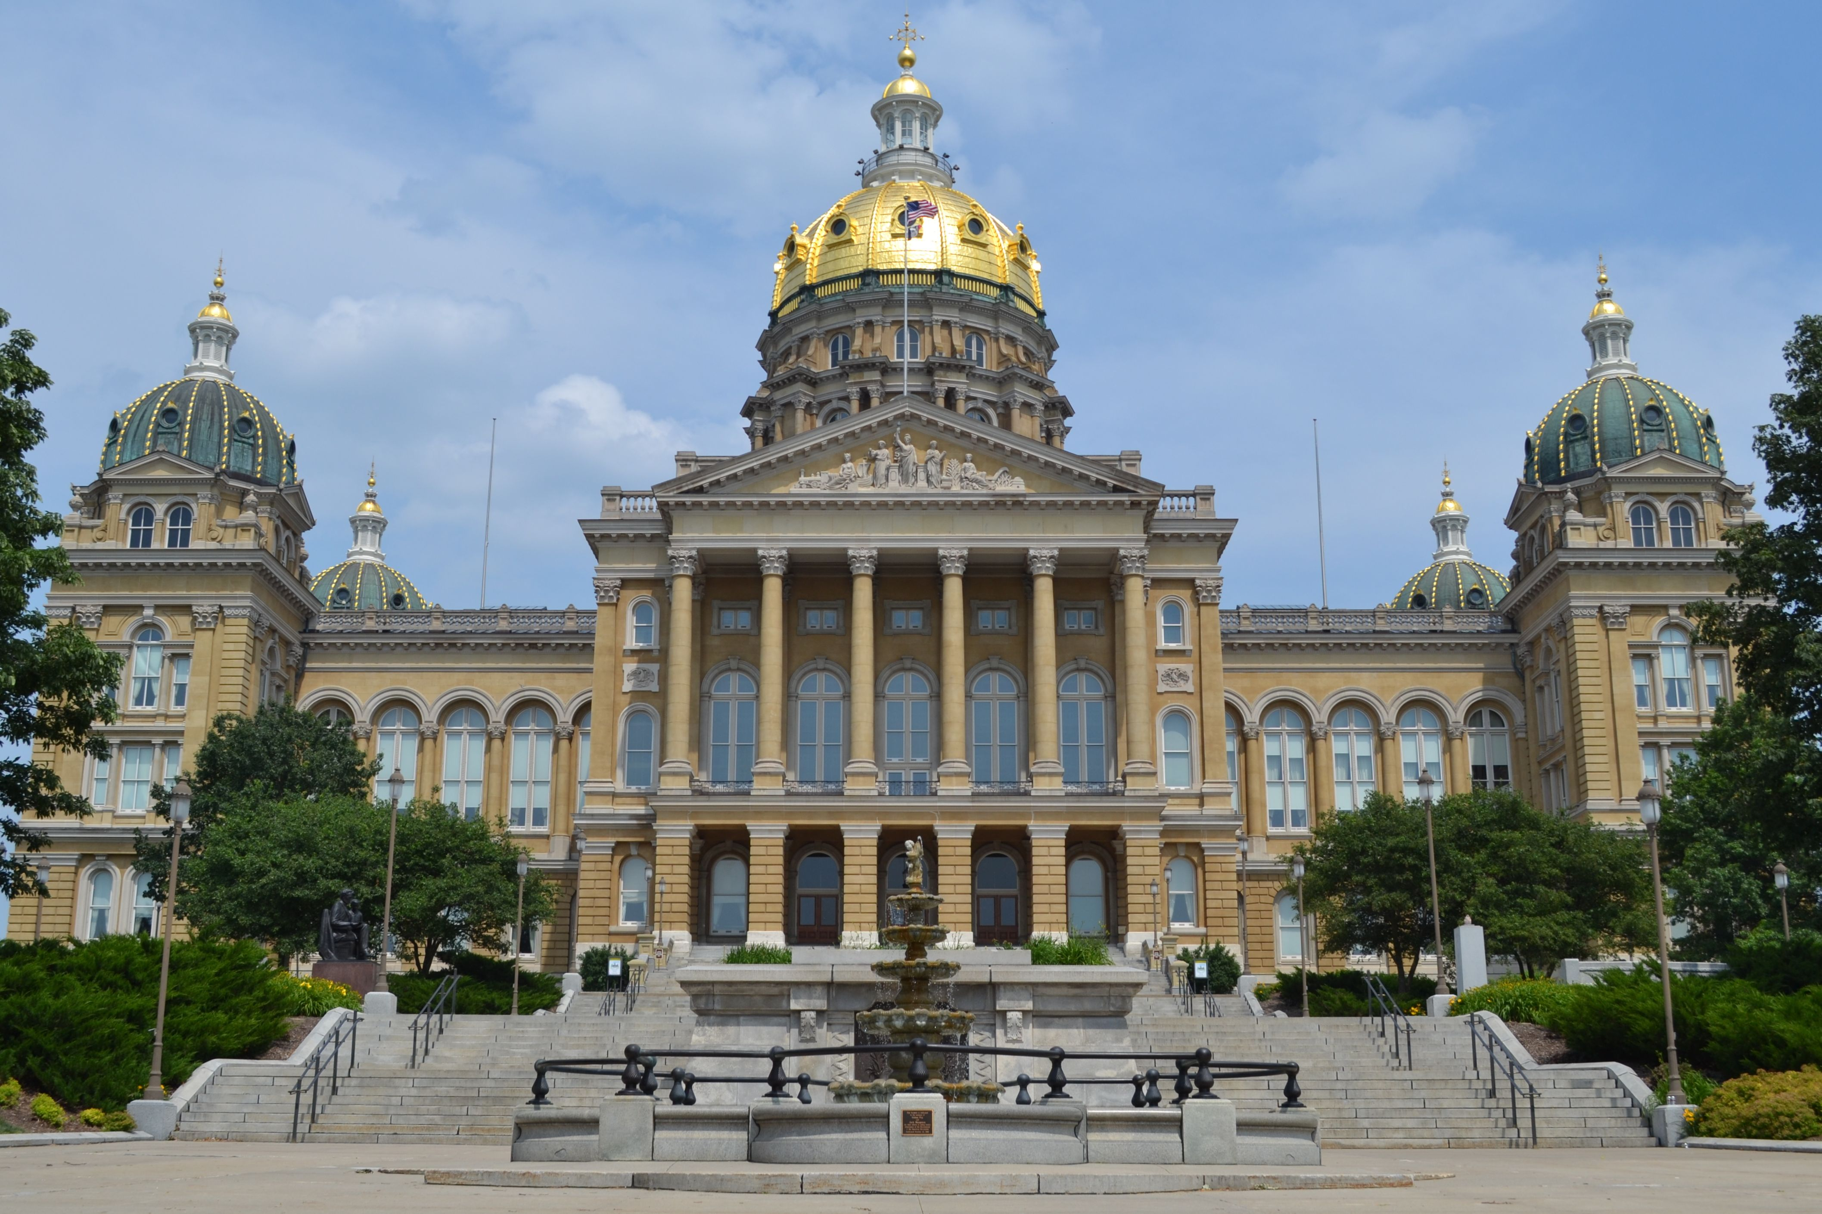
Iowa session update
Passed Legislation
Prior-Authorization Reform
PBM and Prescription Drug Reform
Failed Legislation
Artificial Intelligence and Prior-Authorization
Coverage Restrictions on Contraceptives
Insulin Copay Cap
Non-Opioid Coverage Mandate

Slide 13

Wisconsin session update
Wisconsin Overview and Legislative Process
Key Legislative Issues
Redistricting
State Budget
  Reinsurance
PBM Legislation
Prior-Authorization
Coverage Mandates
Telehealth Licensure

Slide 14

Looking ahead – what’s next?
Continued Scrutiny on Health Policy
Artificial Intelligence
Community Integrated versus National Plans
Rural Challenges to Coverage and Access

Slide 15
Thank you!
Questions?

